Slide 1

AZURE WORKSHOP
Welcome to Technology WORLD
Full Stack Development
Devops
Azure Suites
Data Science
Road maps to All Technology
Resume Preparation

Slide 2

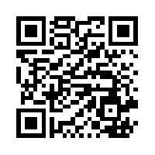
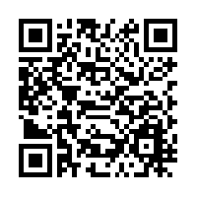
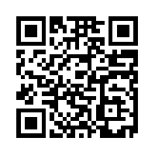
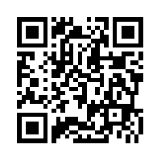
Tech Insights
About Me :
Asst.Vice President of large MNC (Fintech Company)
Full Stack Developer
Cloud Architect
ML Engineer
Data Science Aspirant
Blogger
Linked In
Facebook
Instagram
GitHub Profile

Slide 3

Created By : Abhishek Panda

Slide 4
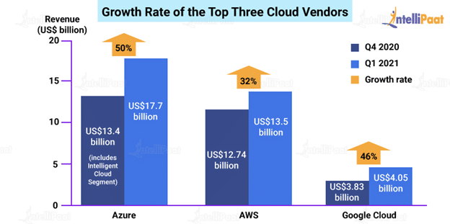
Growth Rate of Azure /AWS/ GCP
Created By : Abhishek Panda

Slide 5
Azure Customers
DAIMLER AG
McKesson Group
Asos
Center of Disease Control (CDC) – US
National Health Service (NHS) – UK
HSBC
Starbucks
Walgreens
3M
HP
Mitsubishi Electric
Renault
Created By : Abhishek Panda

Slide 6
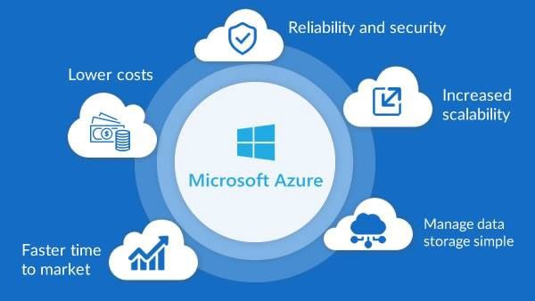
Created By : Abhishek Panda

Slide 7

Azure Suites RoadMap
AZURE SUITES
Az-900
Az-104
Az-204
Az-303/304
Az-400
Created By : Abhishek Panda

Slide 8
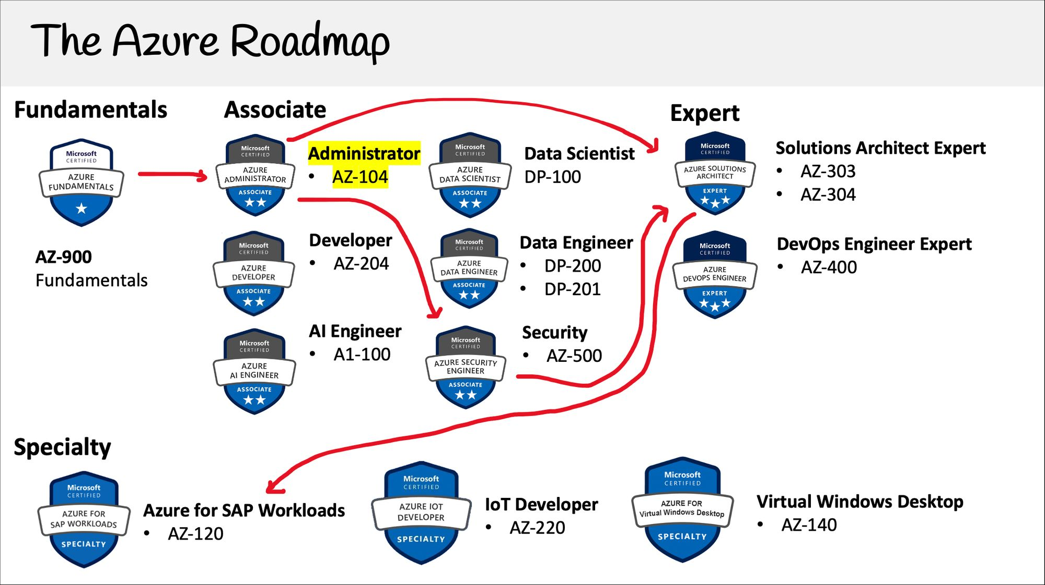

Slide 9
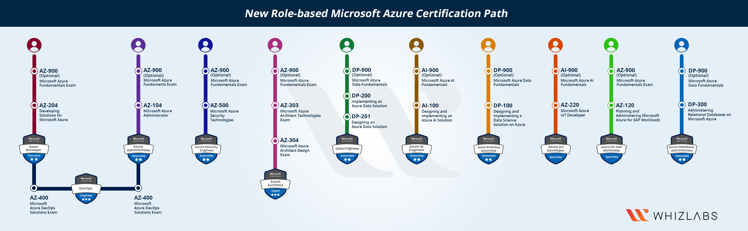
Azure- Certification Path
Created By : Abhishek Panda

Slide 10
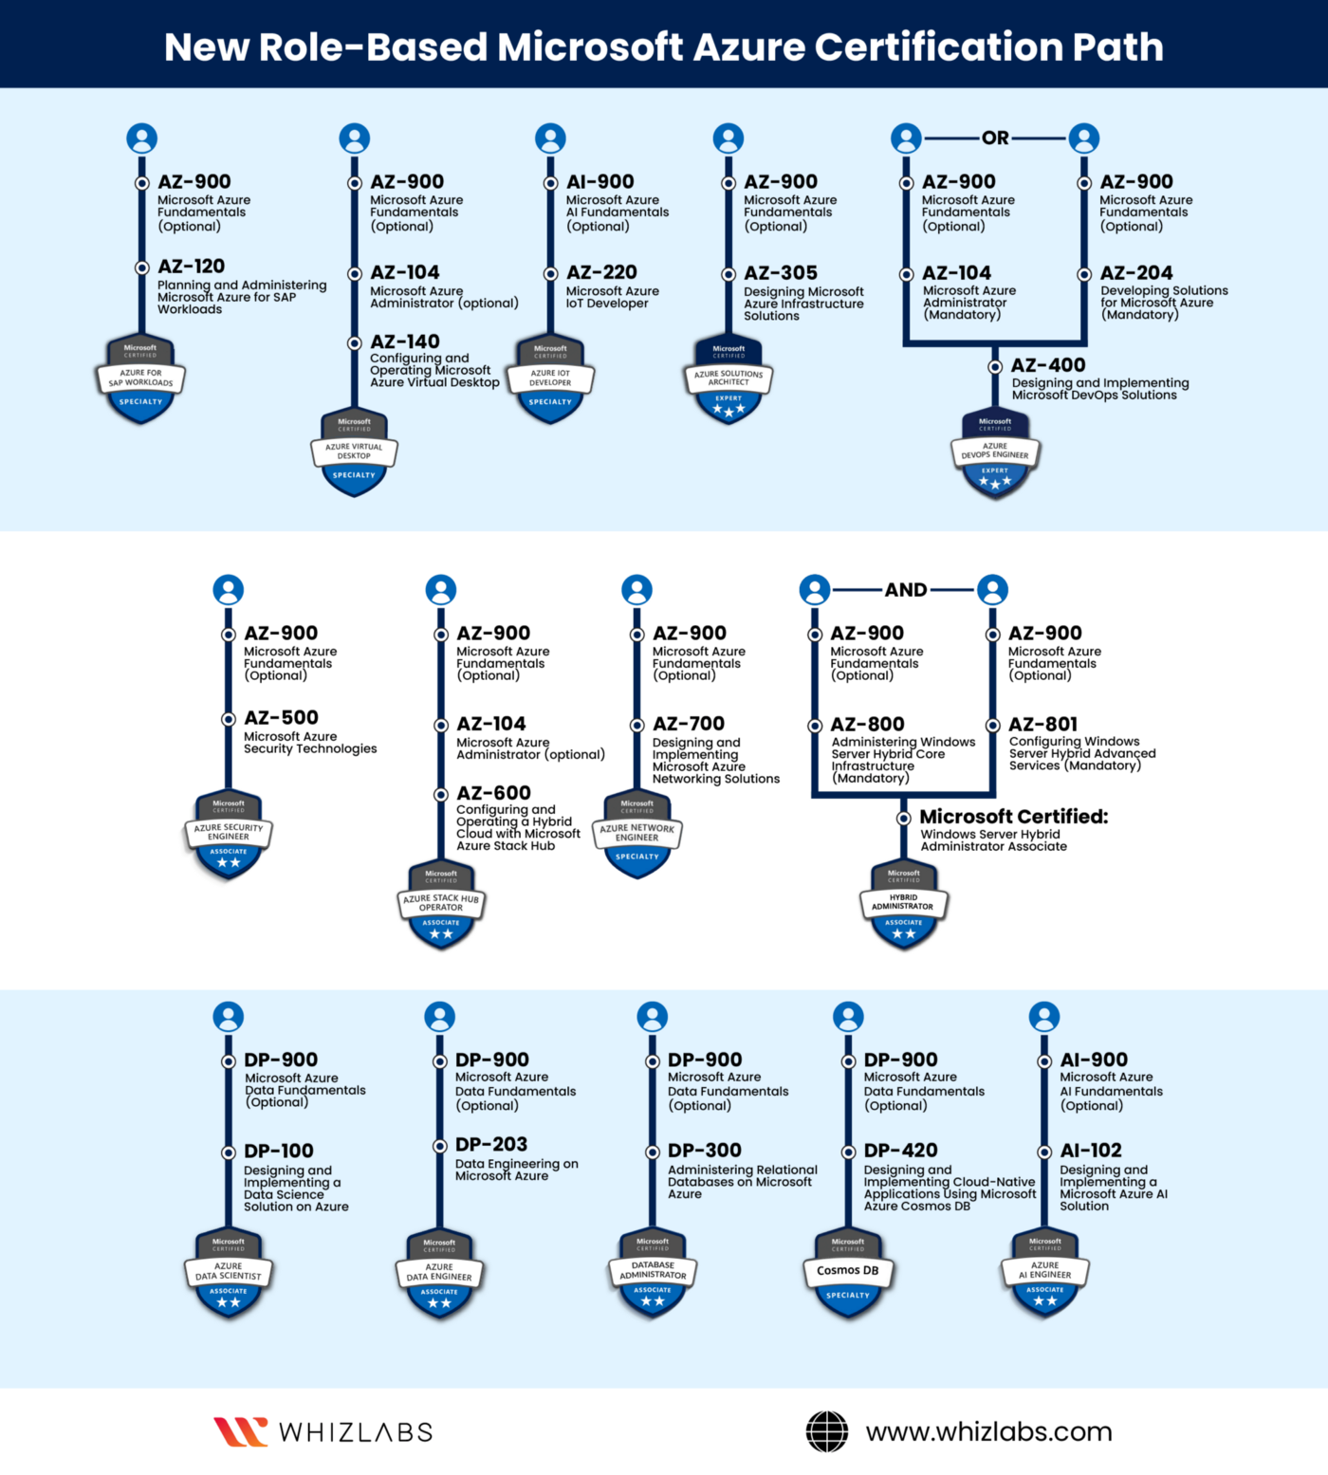

Slide 11
Advance Certification
Microsoft Azure AI Engineer – AI-100.
Microsoft Azure Data Scientist – DP-100.
Microsoft Azure Data Scientist – DP-200 and DP-201.
Microsoft Azure Solutions Architect – AZ-300.
Microsoft Azure DevOps Engineer – AZ-400.
Created By : Abhishek Panda

Slide 12
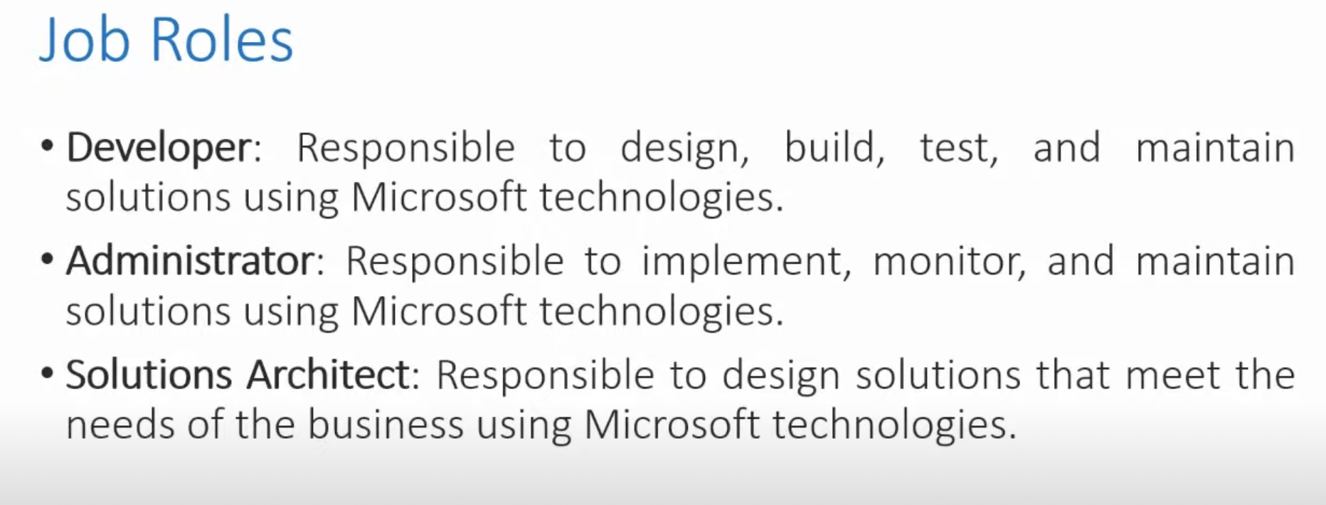
Job Roles and Certification
Created By : Abhishek Panda

Slide 13
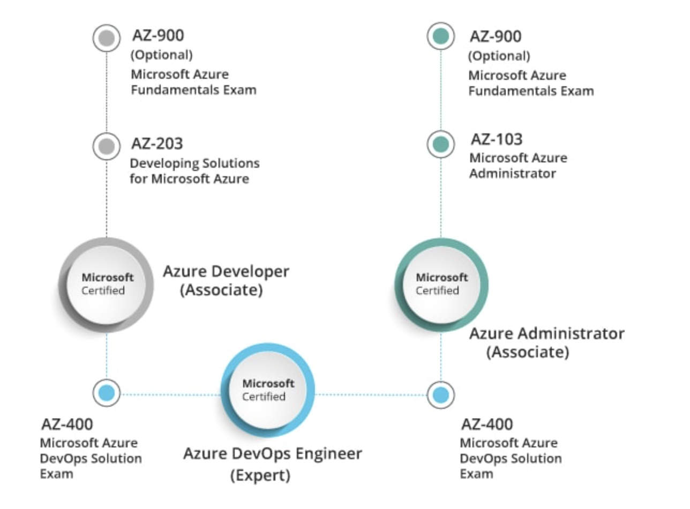
Role Based Certification
Created By : Abhishek Panda

Slide 14
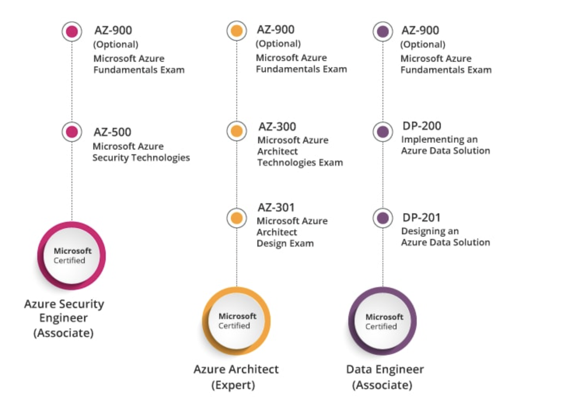
Role Based Certification
Created By : Abhishek Panda

Slide 15
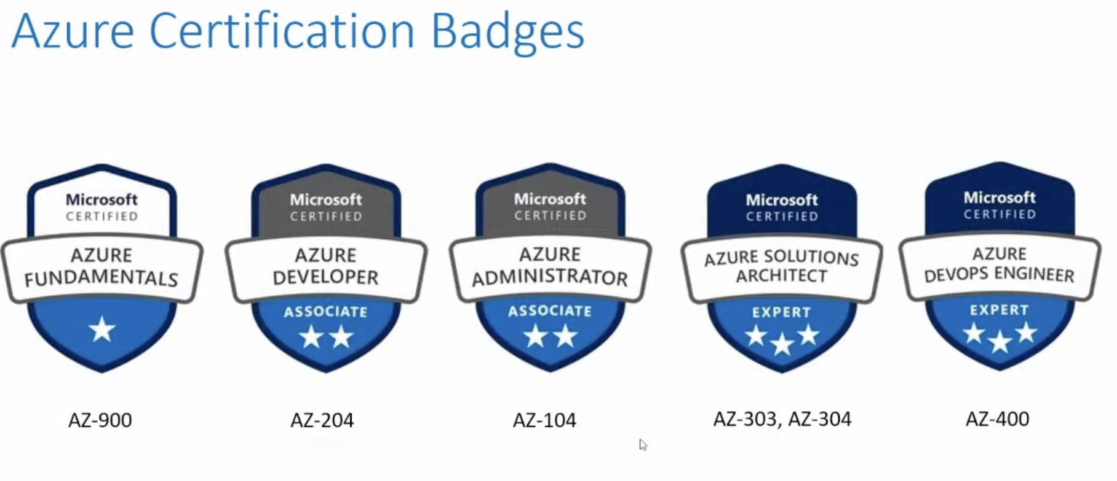
Job Roles and Certification
Created By : Abhishek Panda

Slide 16
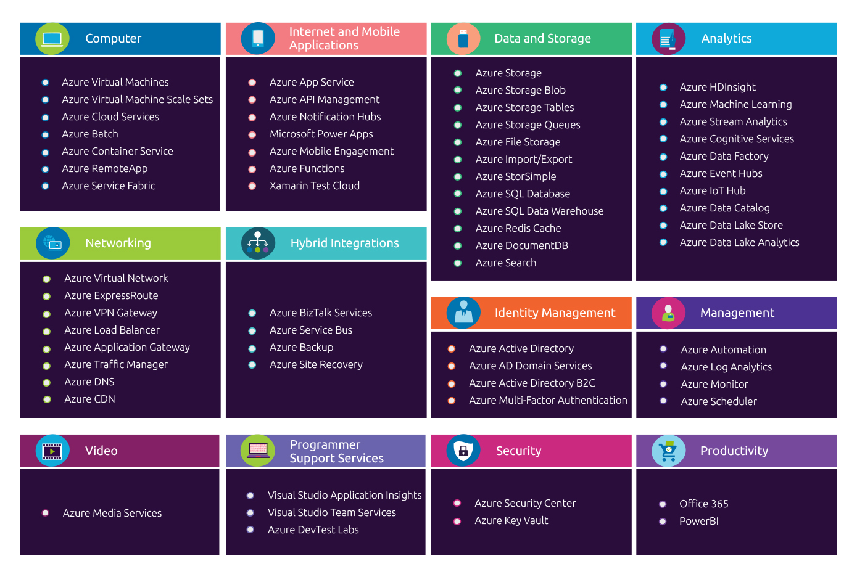
Azure Services

Slide 17
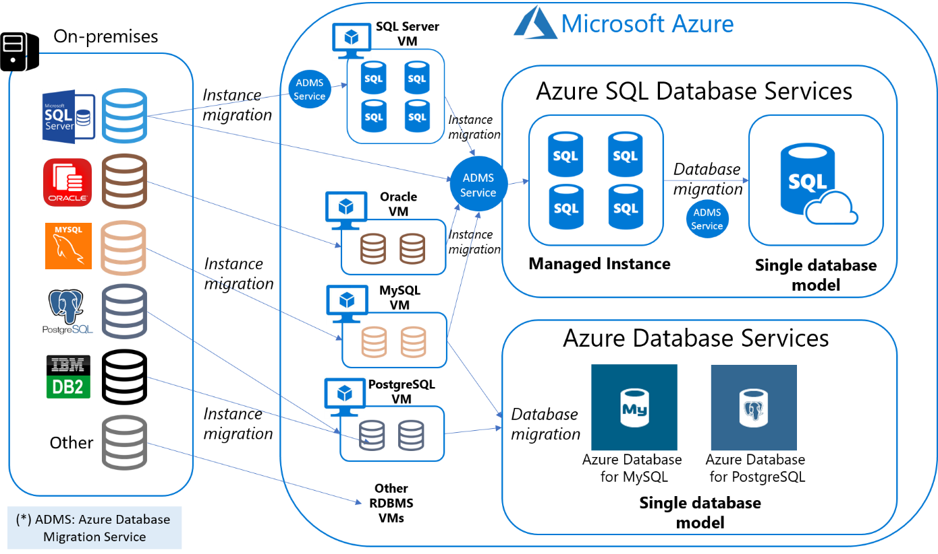
Created By : Abhishek Panda

Slide 18
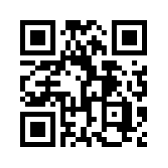
Connect With Me
My Dear Friends ,
Please Connect With me
Facebook : https://www.facebook.com/people/Abhishek-Panda/100072435410563/
Linked in : https://www.linkedin.com/in/abhishek-panda-956312213/
Instagram : https://www.instagram.com/the_abhishekpanda/
Telegram :

Slide 19
Thank you Tech Insight/ Tech Sutta Bar family
Enter to LEARN & Exit to EARN
If you want the Notes and Contents please Telegram me :

